Slide 1
3413ICT Network Security
Lecture 3B. Authentication Application & IP Security
Dr V. Muthukkumarasamy
B.Sc.Eng (Hons) (Peradeniya), PhD (Cantab), MIEE, MIEEE
Notes:
Griffith University, School of ICT
2010/1
3400ICT Information System Security
1
Griffith University, School of ICT
2010/1
3400ICT Information System Security
1

Slide 2
Previous Lecture..
Have considered:
Email security services
PGP
S/MIME

Slide 3
If a secret piece of news is divulged by a spy before the time is ripe, he must be put to death, together with the man to whom the secret was told.
—The Art of War, Sun Tzu

Slide 4
Objectives
To learn about the use of digital signatures
To study various authentication protocols
To explain the operation of Kerberos
To understand the use of X.509 certificates
To understand the IP Security Architecture
To study the details of Authentication Header & Encapsulating Security Payload
To explain the Key Management

Slide 5
References
Cryptography and Network Security: Principles and Practice, 6th ed.,
William Stallings, Chapter 20

Slide 6
Authentication Applications
Developed to support application-level authentication & digital signatures;
Will consider Kerberos – a private-key authentication service;
X.509 directory authentication service.

Slide 7
Kerberos
Trusted key server system from MIT;
Provides centralised private-key third-party authentication in a distributed network:
Allows users access to services distributed through network without needing to trust all workstations,
Rather all trust a central authentication server;
Notes:
One of the best known and most widely implemented trusted third party key distribution systems. It was developed as part of Project Athena at MIT.

Slide 8
Kerberos Requirements
First published report identified its requirements as:
Security,
Reliability,
Transparency,
Scalability.
Implemented using an authentication protocol based on Needham-Schroeder.

Slide 9
Kerberos 4 Overview
Basic third-party authentication scheme;
Have an Authentication Server (AS):
Users initially negotiate with AS to identify self,
AS provides a non-corruptible authentication credential (ticket granting ticket TGT);
Have a Ticket Granting server (TGS):
Users subsequently request access to other services from TGS on basis of users TGT.
Notes:
The core of Kerberos is the Authentication and Ticket Granting Servers – these are trusted by all users and servers and must be securely administered.

Slide 10
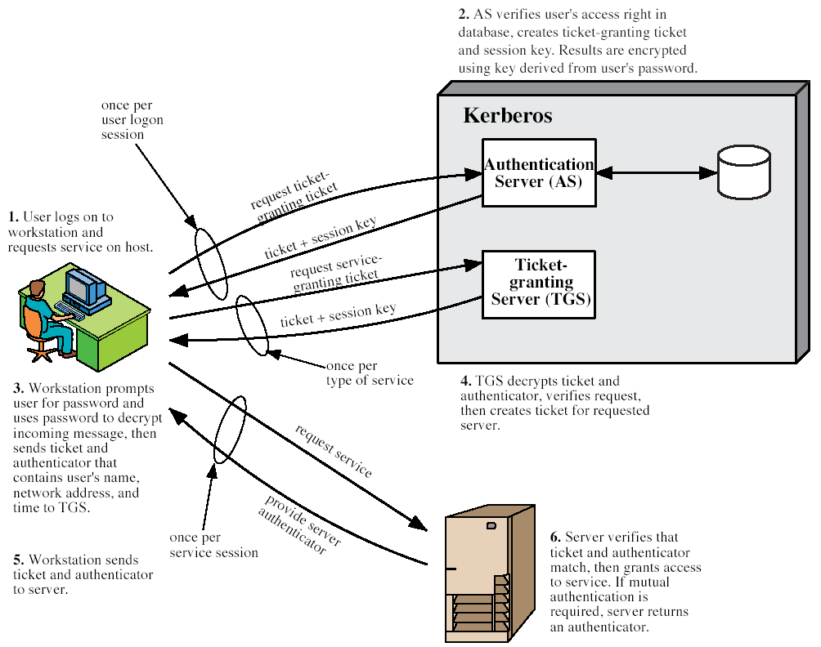
Kerberos 4 Overview
(Stallings Fig 14.1)
Notes:
Stallings Fig 14.1. Discuss in relation to Table 14.1 which details message exchanges.

Slide 11
Kerberos Realms
Kerberos environment consists of:
Kerberos server,
A number of clients, all registered with server,
Application servers, sharing keys with server;
This is termed a realm:
Typically a single administrative domain;
If have multiple realms, their Kerberos servers must share keys and trust.

Slide 12
Kerberos Version 5
Developed in mid 1990’s;
Provides improvements over v4:
Addresses environmental shortcomings:
encryption alg, network protocol, byte order, ticket lifetime, authentication forwarding, interrealm auth,
Technical deficiencies:
double encryption, non-standard mode of use, session keys, password attacks,
Specified as Internet standard RFC 1510.

Slide 13
X.509 Authentication Service
Part of CCITT X.500 directory service standards
Distributed servers maintaining some info database;
Defines framework for authentication services:
Directory may store public-key certificates with public key of user signed by certification authority;
Also defines authentication protocols;
Uses public-key crypto & digital signatures:
Algorithms not standardised, but RSA recommended.
Notes:
X.509 is the Internationally accepted standard for how to construct a public key certificate, and is becoming widely used. It has gone through several versions. It is used by S/MIME secure email, SSL/TLS secure Internet links (eg for secure web).

Slide 14
X.509 Certificates
Issued by a Certification Authority (CA), containing:
version (1, 2, or 3)
serial number (unique within CA) identifying certificate
signature algorithm identifier
issuer X.500 name (CA)
period of validity (from - to dates)
subject X.500 name (name of owner)
subject public-key info (algorithm, parameters, key)
issuer unique identifier (v2+)
subject unique identifier (v2+)
extension fields (v3)
signature (of hash of all fields in certificate)
Notation CA<<A>> denotes certificate for A signed by CA
Notes:
The X.509 certificate is the heart of the standard. There are 3 versions, with successively more info in the certificate - must be v2 if either unique identifier field exists, must be v3 if any extensions are used.

Slide 15
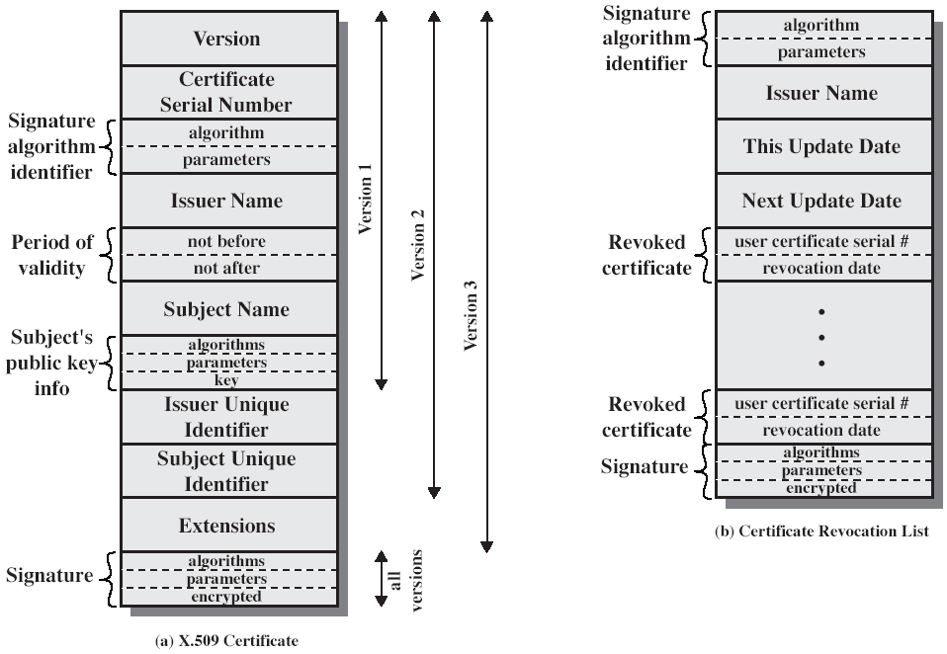
X.509 Certificates
(Stallings Fig 14.3)
Notes:
Stallings Fig 14.3

Slide 16
Obtaining a Certificate
Any user with access to CA can get any certificate from it;
Only the CA can modify a certificate;
Because it cannot be forged, certificates can be placed in a public directory.

Slide 17
CA Hierarchy
If both users share a common CA then they are assumed to know its public key;
Otherwise CA's must form a hierarchy;
Use certificates linking members of hierarchy to validate other CA's:
each CA has certificates for clients (forward) and parent (backward);
Each client trusts parent’s certificates;
Enable verification of any certificate from one CA by users of all other CAs in hierarchy.
Notes:
All very easy is both parties use the same CA. If not, then there has to be some means to form a chain of certifications between the CA's used by the two parties. And that raises issues about whether the CA's are equivalent, whether they used the same policies to generate their certificates, and how much you're going to trust a CA at some remove from your own. These are all open issues.

Slide 18
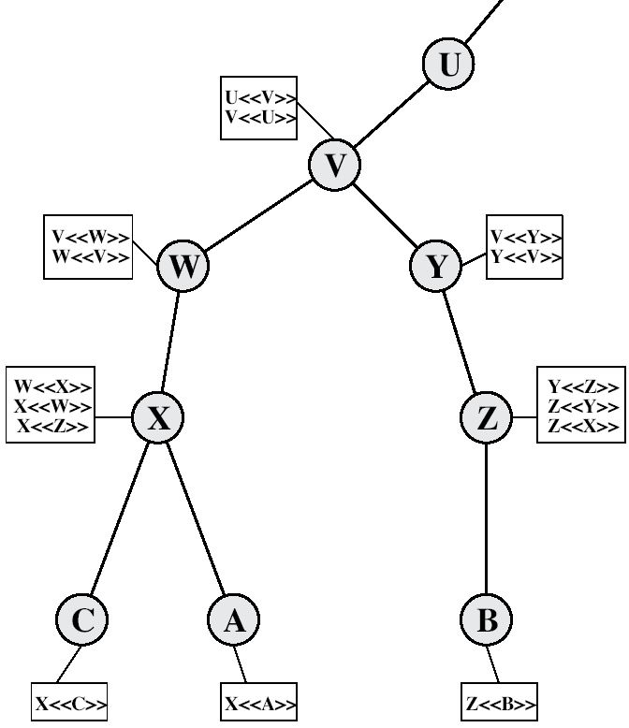
CA Hierarchy Use
(Stallings Fig 14.4)
Notes:
Stallings Fig 14.4.
Track chains of certificates:
A acquires B certificate using chain: X<<W>>W<<V>>V<<Y>>Y<<Z>>Z<<B>>
B acquires A certificate using chain: Z<<Y>>Y<<V>>V<<W>>W<<X>>X<<A>>

Slide 19
Certificate Revocation
Certificates have a period of validity;
May need to revoke before expiry, e.g.:
User's private key is compromised,
User is no longer certified by this CA,
CA's certificate is compromised;
CA’s maintain list of revoked certificates, the Certificate Revocation List (CRL);
Users should check certs with CA’s CRL.

Slide 20
Authentication Procedures
X.509 includes three alternative authentication procedures:
One-Way Authentication,
Two-Way Authentication,
Three-Way Authentication;
All use public-key signatures.
Notes:
The X.509 standard specifies the authentication protocols that can be used when obtaining and using certificates. 1-way for unidirectional messages (like email), 2-way for interactive sessions when timestamps are used, 3-way for interactive sessions with no need for timestamps (and hence synchronised clocks).

Slide 21
One-Way Authentication
1 message ( A->B) used to establish:
The identity of A and that message is from A,
Message was intended for B,
Integrity & originality of message;
Message must include timestamp, nonce, B's identity and is signed by A.

Slide 22
Two-Way Authentication
2 messages (A->B, B->A) which also establishes in addition:
The identity of B and that reply is from B,
That reply is intended for A,
Integrity & originality of reply;
Reply includes original nonce from A, also timestamp and nonce from B.

Slide 23
Three-Way Authentication
3 messages (A->B, B->A, A->B) which enables above authentication without synchronized clocks;
Has reply from A back to B containing signed copy of nonce from B;
Means that timestamps need not be checked or relied upon.

Slide 24
X.509 Version 3
Has been recognised that additional information is needed in a certificate:
email/URL, policy details, usage constraints
Rather than explicitly naming new fields defined a general extension method:
extensions consist of:
extension identifier,
criticality indicator,
extension value.

Slide 25
Certificate Extensions
Key and policy information:
Convey info about subject & issuer keys, plus indicators of certificate policy;
Certificate subject and issuer attributes:
Support alternative names, in alternative formats for certificate subject and/or issuer;
Certificate path constraints:
allow constraints on use of certificates by other CA’s.

Slide 26
IP Security
have considered some application specific security mechanisms
eg. S/MIME, PGP, Kerberos
however there are security concerns that cut across protocol layers
would like security implemented by the network for all applications
even for security-ignorant applications

Slide 27
IPSec
general IP Security mechanisms
provides
authentication
confidentiality
key management (concerned with secure exchange of keys)
applicable to use over LANs, across public & private WANs, & for the Internet

Slide 28
IPSec
In 1994 IAB (Internet Architecture Board) recognized the need for better security in the Internet
To ensure unauthorised monitoring & control of network traffic
To secure end user-to-end user traffic using authentication and encryption
Recent CERT confirms the need
Increased attacks on the network
IP spoofing
Various forms of eavesdropping
Packet sniffing (including logon)

Slide 29
Applications
IPSec is designed to be useable with IPv4 & IPv6
IPSec applications provides secure communication across a LAN, WAN etc.
Secure branch office connectivity over the Internet
Reduce the need for private network
Saving cost and network management overhead
Secure remote access over the Internet
Establishing extranet and intranet connectivity with partners
Enhancing e-commerce security
Principal features of IPSec:
Can encrypt and/or authenticate all traffic at IP level

Slide 30
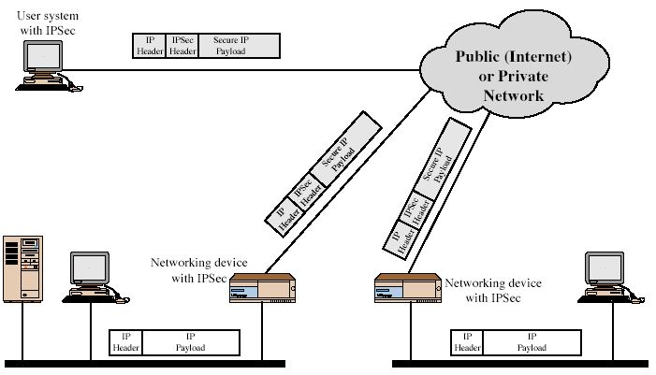
IPSec Users
Notes:
Stallings Fig 16-1.

Slide 31
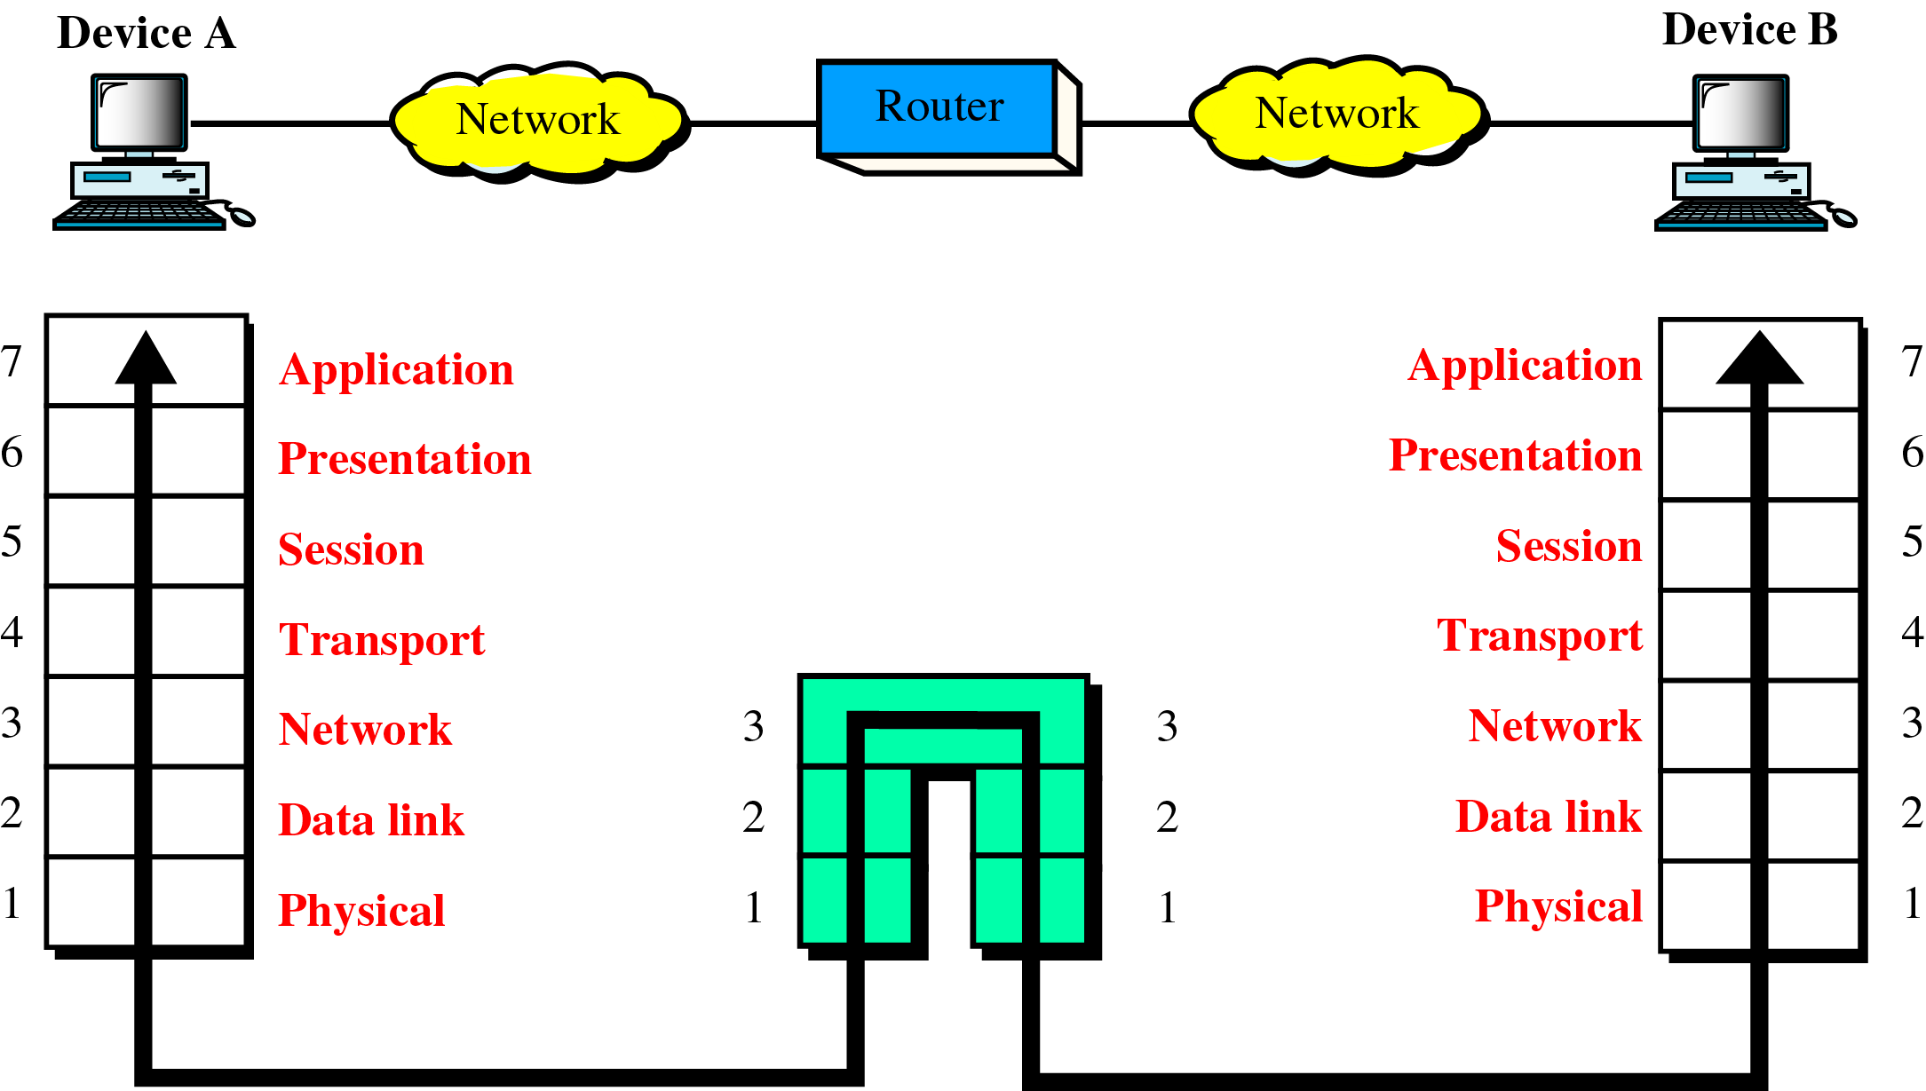
Router in the OSI Model

Slide 32
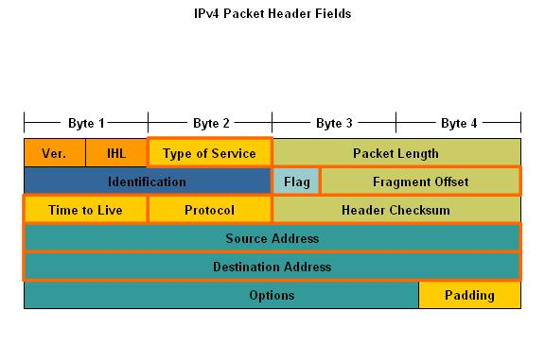
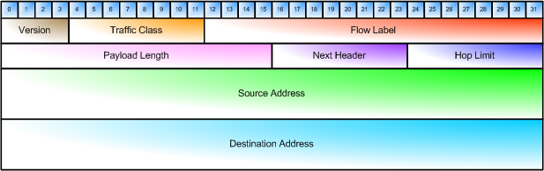
IPv4 v.s.IPv6
IPv4:
192-bit (24 byte) header
4 byte IP address
IPv6:
320-bit (40 byte) header
16 byte IP address
Simpler packet structure

Slide 33
Benefits of IPSec
in a firewall/router provides strong security to all traffic crossing the perimeter
internal traffic does not incur the overhead
is resistant to bypass at firewall
is below transport layer, hence transparent to applications (upper-layer s/w is not affected)
can be transparent to end users- no need to train users
can provide security for individual users if desired (useful for offsite users)

Slide 34
Routing applications
In addition to supporting end users and networks, IPSec plays a role in the routing architecture
IPSec ensures:
A router advertisement comes from an authorised router
A neighbor advertisement & redirect message come from an authorised router
A routing update is not forged

Slide 35
IP Security Architecture
specification is quite complex
defined in numerous RFC’s
incl. RFC 2401/2402/2406/2408
many others, grouped by category
mandatory in IPv6, optional in IPv4

Slide 36
IP Security Architecture
Security features are implemented as extension headers that follow the main IP header
Authentication header for Authentication
Encapsulating Security Payload (ESP) header for encryption

Slide 37
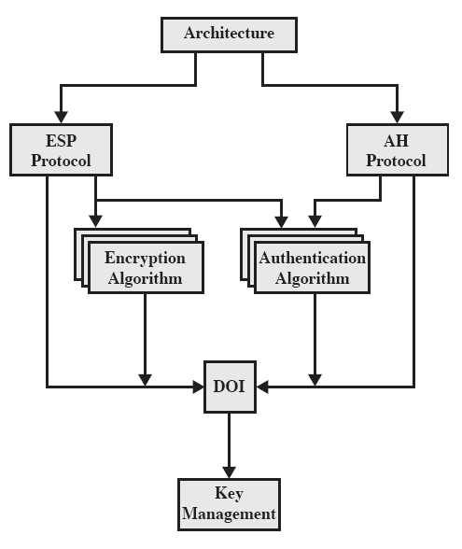
IPSec Document Overview

Slide 38
IPSec Services
Access control
Connectionless integrity
Data origin authentication
Rejection of replayed packets
a form of partial sequence integrity
Confidentiality (encryption)
Limited traffic flow confidentiality

Slide 39
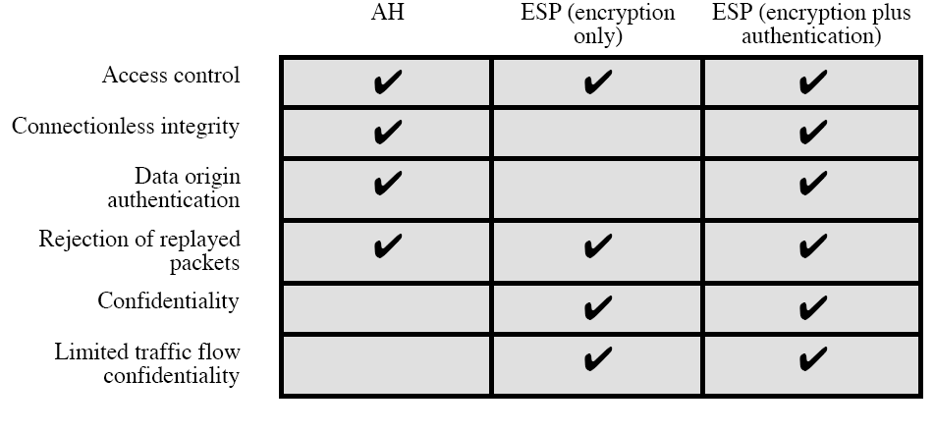
IPSec Services

Slide 40
Security Associations
A key concept in authentication & confidentiality mechanism
a one-way relationship between sender & receiver that affords security for traffic flow
defined by 3 parameters:
Security Parameters Index (SPI)
SPI is carried in AH & ESP headers
Enables the receiver to select the SA under which a packet will be processed
IP Destination Address
End point of SA: may be end user firewall or router
Security Protocol Identifier
as AH or ESP

Slide 41
Security Associations
has a number of other parameters
seq no, AH & EH info, lifetime etc
have a database of Security Associations that defines the parameters associated with each SA
IP traffic is related to specific SAs by means of the nominal Security Policy Database (SPD)

Slide 42
SA Selectors
The SA selectors, which determine an SPD entry are:
Destination IP address
Source IP address
User ID
Data security level
Transport layer protocol
IPSec Protocol (AH or ESP or AH/ESP)
Source & destination ports
IPv6 Class
IPv6 Flow label
IPv4 Type of Service

Slide 43
Transport Mode
Both AH & ESP support 2 modes of use:
Transport Mode and Tunnel Mode
Transport mode provides protection for upper layer protocols
Protection extends to the payload of an IP packet (eg. TCP/ UDP segment)
Used for end-to-end communication between 2 hosts
Over IPv6, payload is the data that follow both the IP header and any IPv6 extensions headers
ESP encrypts/ authenticates the IP payload but not the header
AH authenticate the IP payload and selected portions of the IP header

Slide 44
Tunnel Mode
Provides protection to the entire IP packet
After AH & ESP fields are added to the IP packet, the entire payload is added with a new outer IP header
The entire original packet travels through the tunnel
No routers along the way are able to examine the inner IP header
Tunnel mode is used when one or both ends of an SA is a security gateway

Slide 45
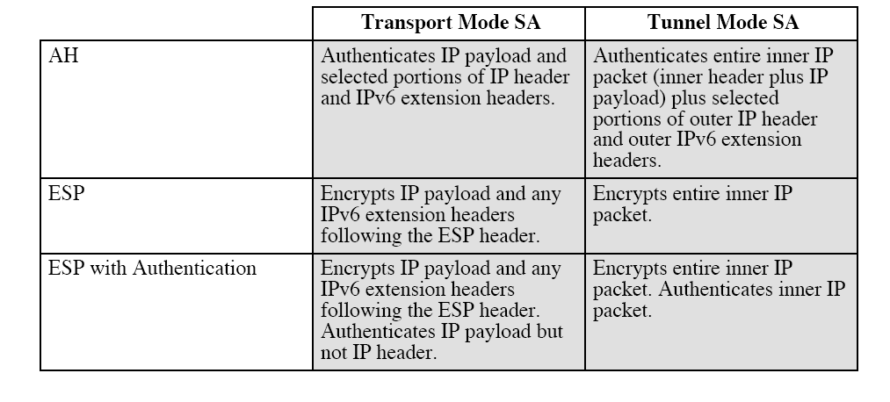
Tunnel Mode & Transport Mode Functionality

Slide 46
Authentication Header (AH)
provides support for data integrity & authentication of IP packets
end system/router can authenticate user/app
prevents address spoofing attacks by tracking sequence numbers
based on use of a MAC (message authentication code)
HMAC-MD5-96 or HMAC-SHA-1-96
parties must share a secret key

Slide 47
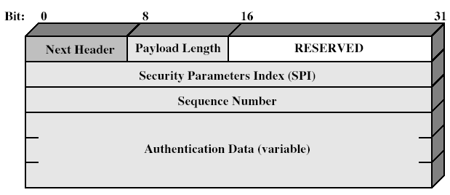
Authentication Header
Notes:
Stallings Fig 16-3.

Slide 48
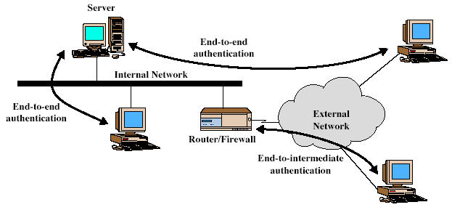
End-to-End Vs End-to-Intermediate Authentication
Notes:
Stallings Fig 16-5.

Slide 49
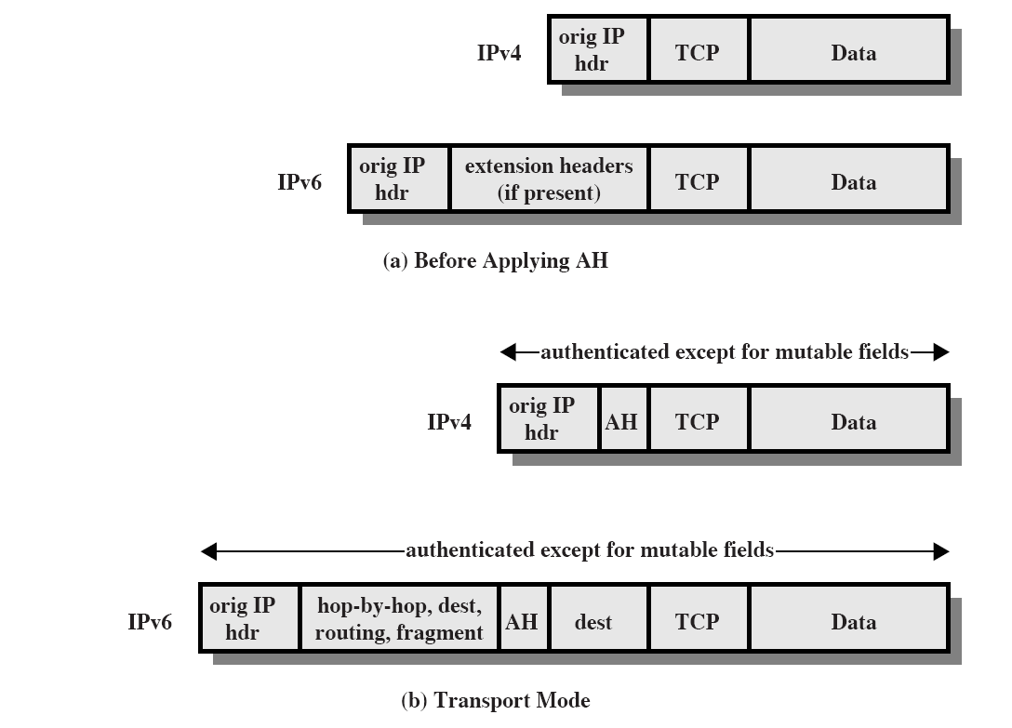
Scope of AH Authentication

Slide 50
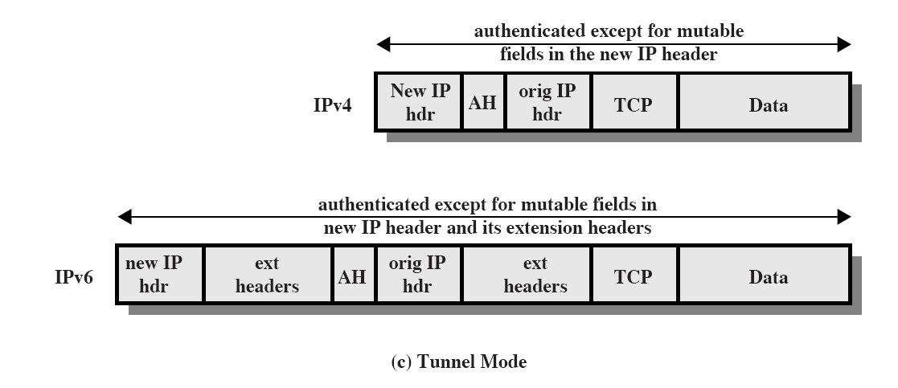
Scope of AH Authentication

Slide 51
Encapsulating Security Payload (ESP)
provides message content confidentiality & limited traffic flow confidentiality
can optionally provide the same authentication services as AH
supports range of ciphers, modes, padding
incl. DES, Triple-DES, RC5, IDEA, CAST etc
CBC (cipher block chaining) most common
pad to meet blocksize, for traffic flow

Slide 52
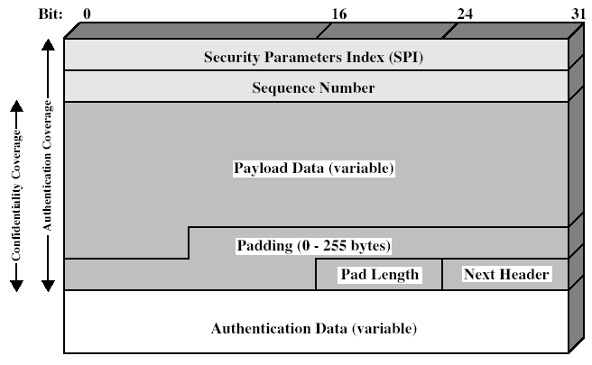
Encapsulating Security Payload
Notes:
Stallings Fig 16-7.

Slide 53
Transport vs Tunnel Mode ESP
transport mode is used to encrypt & optionally authenticate IP data
data protected but header left in clear
can do traffic analysis but is efficient
good for ESP host to host traffic
tunnel mode encrypts entire IP packet
add new header for next hop
good for VPNs, gateway to gateway security

Slide 54
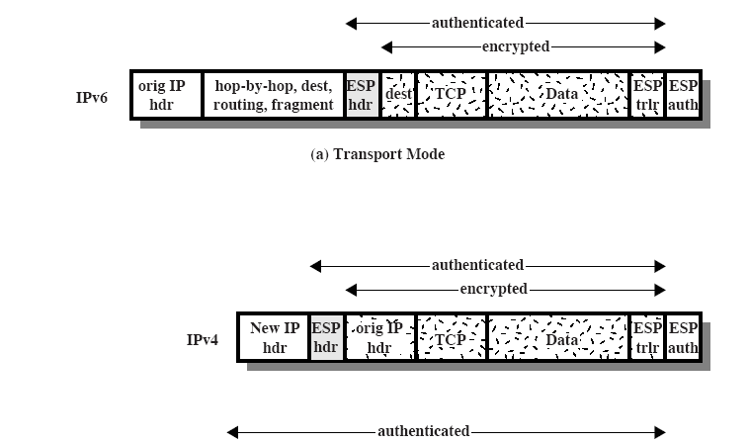
Scope of ESP Encryption & Authentication

Slide 55
Combining Security Associations
SA’s can implement either AH or ESP
to implement both need to combine SA’s
form a security bundle
have 4 cases (see next)

Slide 56
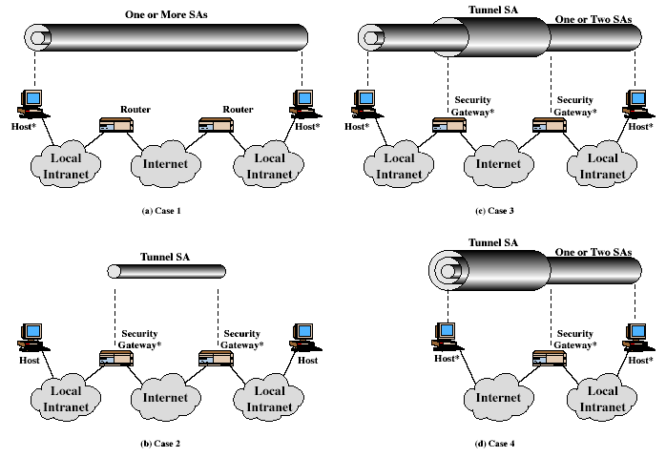
Combining Security Associations
Notes:
Stallings Fig 16-10.

Slide 57
Key Management
handles key generation & distribution
typically need 2 pairs of keys
2 per direction for AH & ESP
manual key management
sysadmin manually configures every system
automated key management
automated system for on demand creation of keys for SA’s in large systems
has Oakley & ISAKMP elements

Slide 58
Oakley
a key exchange protocol
based on Diffie-Hellman key exchange
adds features to address weaknesses
cookies, groups (global params), nonces, DH key exchange with authentication
can use arithmetic in prime fields or elliptic curve fields

Slide 59
ISAKMP
Internet Security Association and Key Management Protocol
provides framework for key management
defines procedures and packet formats to establish, negotiate, modify, & delete SAs
independent of key exchange protocol, encryption alg, & authentication method

Slide 60
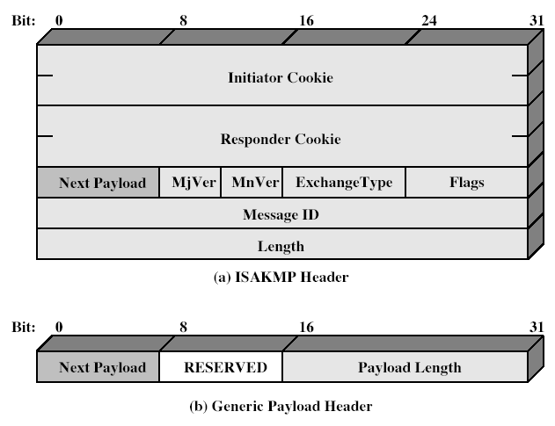
ISAKMP
Notes:
Stallings Fig 16-12.

Slide 61
Summary
have considered:
Kerberos trusted key server system
X.509 authentication and certificates
IPSec security framework
AH
ESP
key management & Oakley/ISAKMP

Slide 62
Next Lecture
Mini Test 1: Wednesday @ 9.00
Lecture: Web Security…

Slide 63

Questions?

